Slide 1
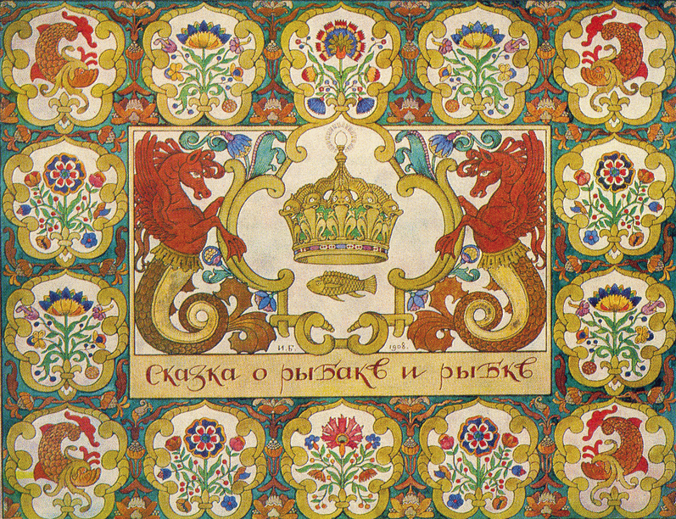
Цели урока
we are going to speak about our country, about its geography, its culture, and of course about symbols of Russia;
to work in teams;
to summarize everything we have learned.

Slide 2
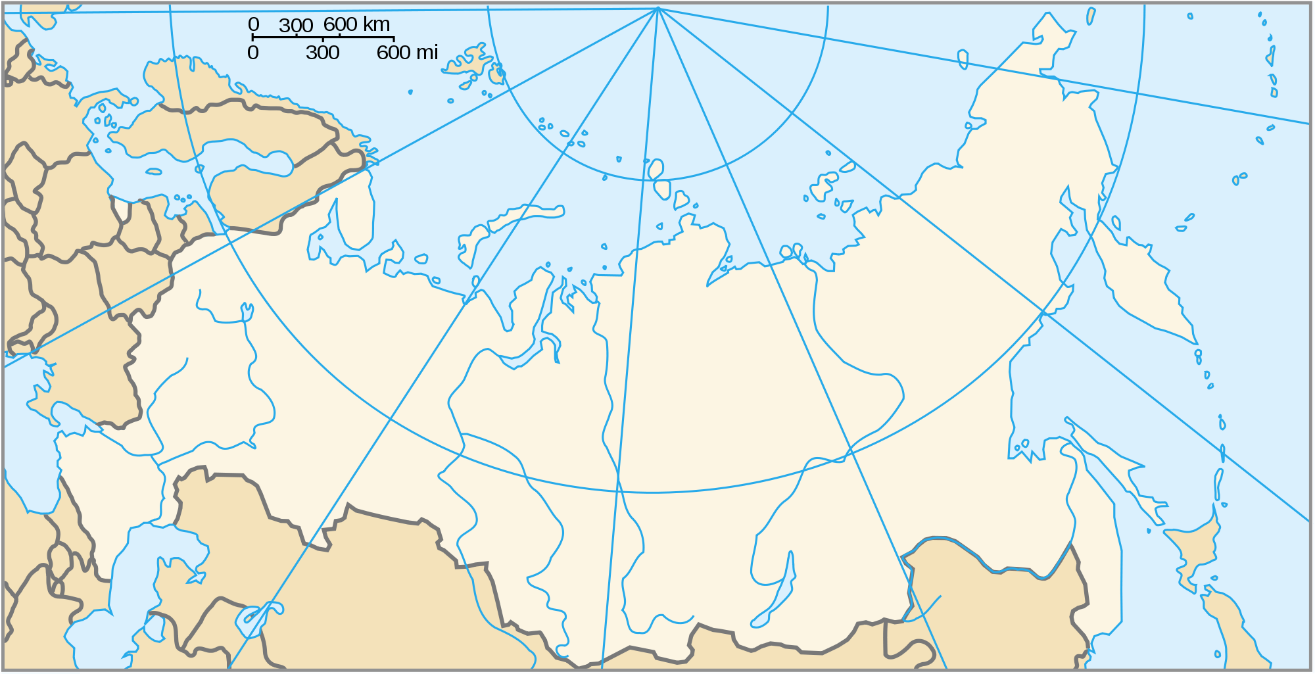
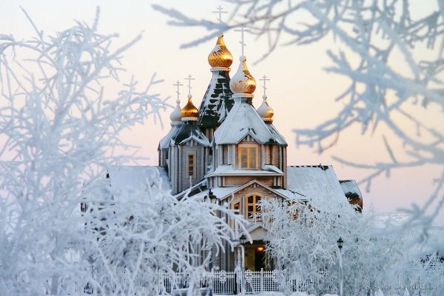
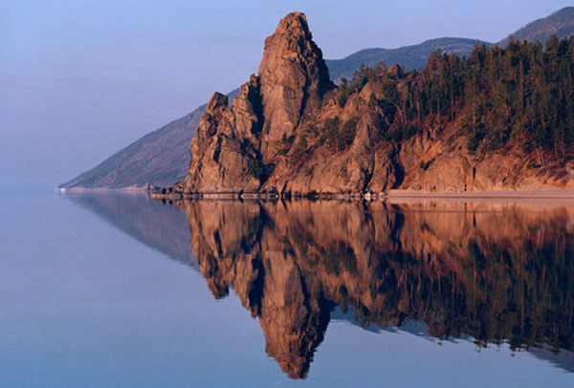
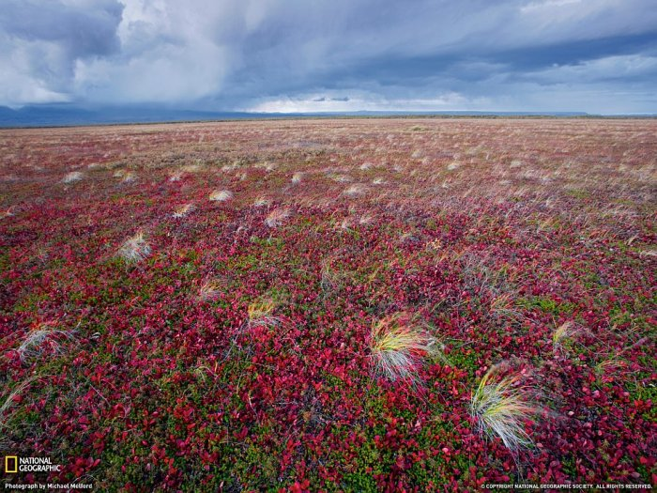
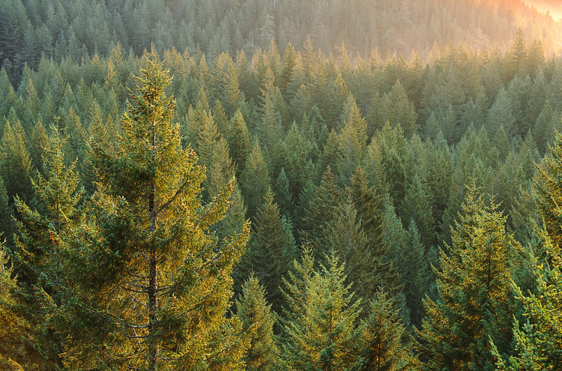
Russian winter
Russia is the largest country in the world. It takes 11 hours to cross it by plane!
Russia has 10 time zones. When people in Kaliningrad are having breakfast, people in Vladivostok are going to bed!
Russia stretches from the Baltic Sea in the West to the Pacific Ocean in the East and from the Northern Arctic Ocean to the deserts of Central Asia.
Russia has a wide range of scenery and climates. It has harsh winters with lots of snow, but the summers are quite warm. The temperature is +20˚ to -25˚C.
Lake Baikal is 636 km long and 80 km wide. It is the world’s biggest fresh water reservoir. The water is very clean. You can see the bottom of the lake through 30-40 m of water.
Mount Elbrus, in the Caucasus, is the highest peak in the country.
Steppes cover all of the south of Russia, from the Black Sea to the Altai Mountains on the Chinese Border.
Almost 18 per cent of Russia is tundra. There aren't any trees there. It is frozen for most of the year.
Taiga is a thick forest with a lot of dark pine, fir, and cedar trees. Many species of wildlife live there.
Baikal
tundra
taiga

Slide 3
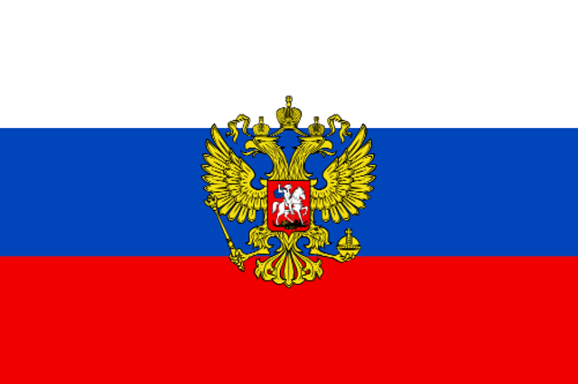
The Russian Flag
The Russian flag first appears in 1668. it was the symbol of Russia for more than 300 years. It reappeared as the modern flag in 1991. The flag has three wide stripes on it. The colors of flag are symbolic. White is faithful and sincere, blue is honest and loyal and red is brave. When Russian people celebrate their national holidays you can see the national flag in all the streets, squares, official buildings, blocks of flats and houses in big cities, small towns and villages.

Slide 4
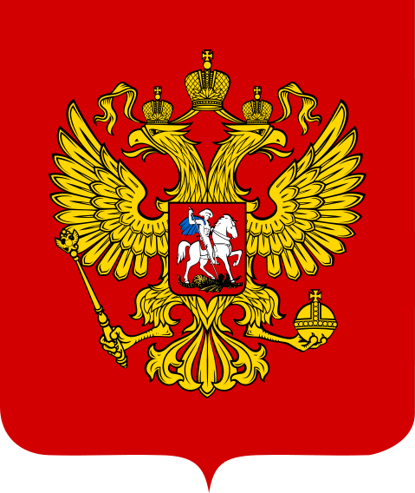
The Double-Headed Eagle
The double-headed eagle is the emblem of Russia. Above the heads there are three crowns. The eagle carries a scepter, the sign of state power, and an orb, the sign of unity. You can see St George on the breast of the eagle. It is the oldest Russian symbol of love for the Motherland. You can also see the eagle on the back of modern Russian coins.
1. ………
2. ………
4. ………
3. ………

Slide 5
Scepter – скипетр
Crown – корона
Sign on the breast – знак покровителя России Святого Георгия Победоносца
Orb – держава

Slide 6
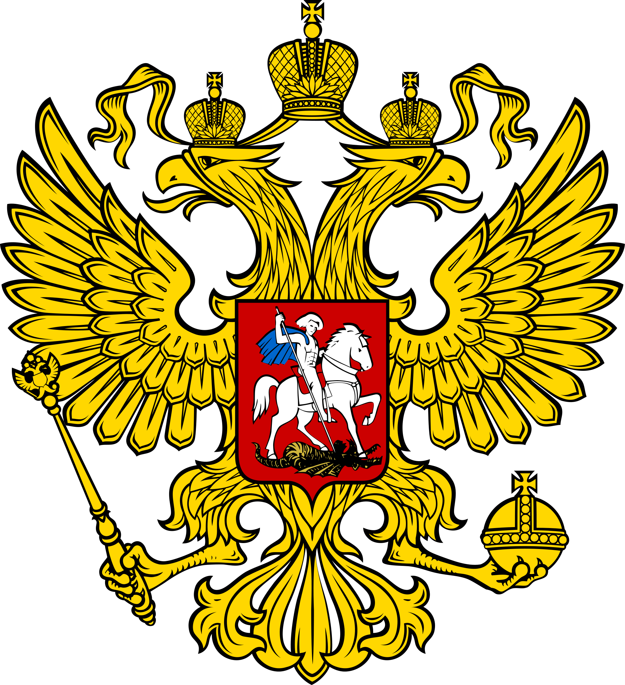
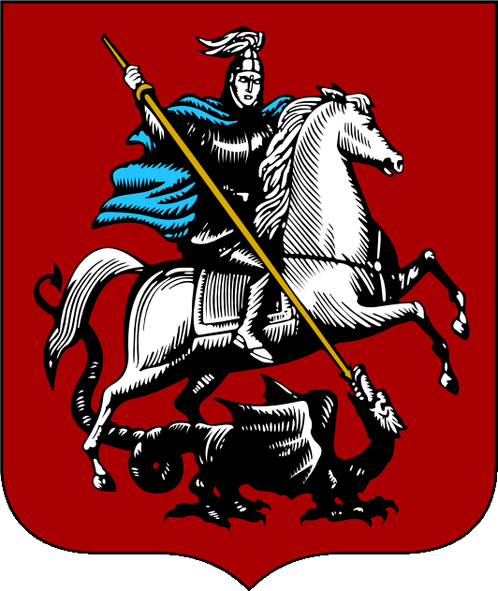
St George

Slide 7
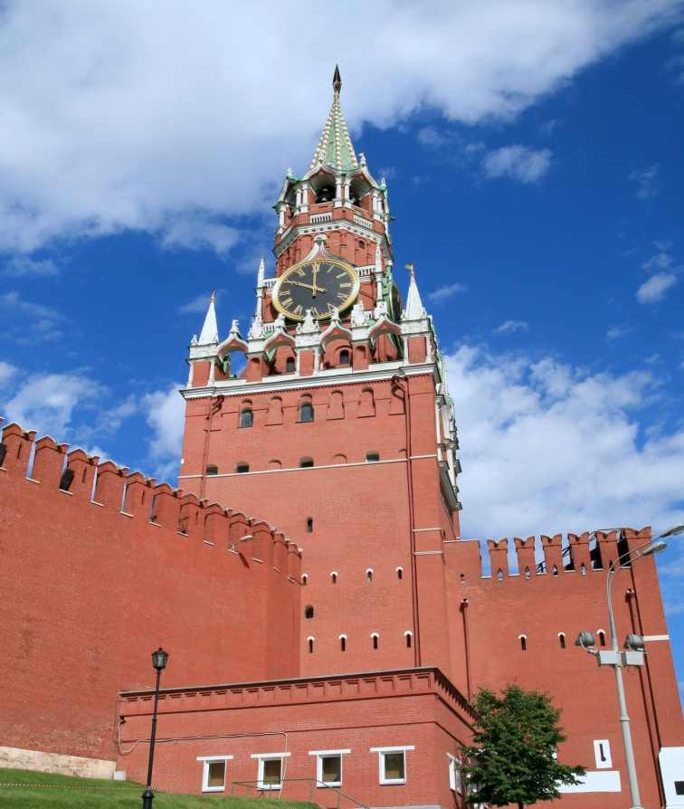
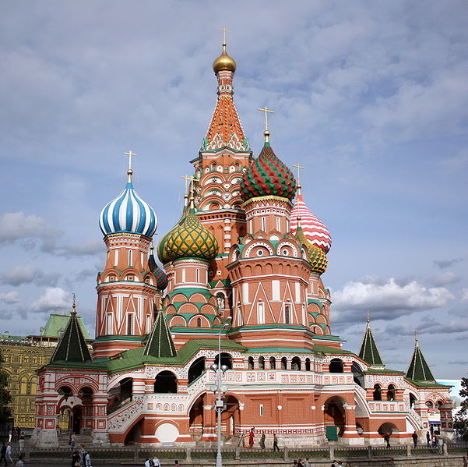
“…And here we are at the heart of Moscow, Red Square. It got its name in 17th century. In old Russian the word red means beautiful. As you can see, Red Square is very large. There are interesting landmarks in it.
In the centre of Red Square, by the Kremlin wall, you can see the Lenin Mausoleum designed by the architect Alexey Victorovich Shchusev. To the left there is the Spasskaya Tower, the tallest of the Kremlin towers. It is 67.3 metres high. The tower if famous for its clock, the Kremlin clock, made in the 16th century. The clock strikes every hour, half hour and quarter hour. The minute hand is 3.38 metres long.
In the square you can also visit the State History Museum and the State Department Store(GUM). The most famous building in Red Square is St Basil’s Cathedral. There are eight smaller churches around the tallest ninth church.
Next to the Cathedral, there is a monument to citizen Minin and Prince Pozharsky. They were heroes in the war against Poland in 1612. it was the first monument built in Moscow. ”

Slide 8
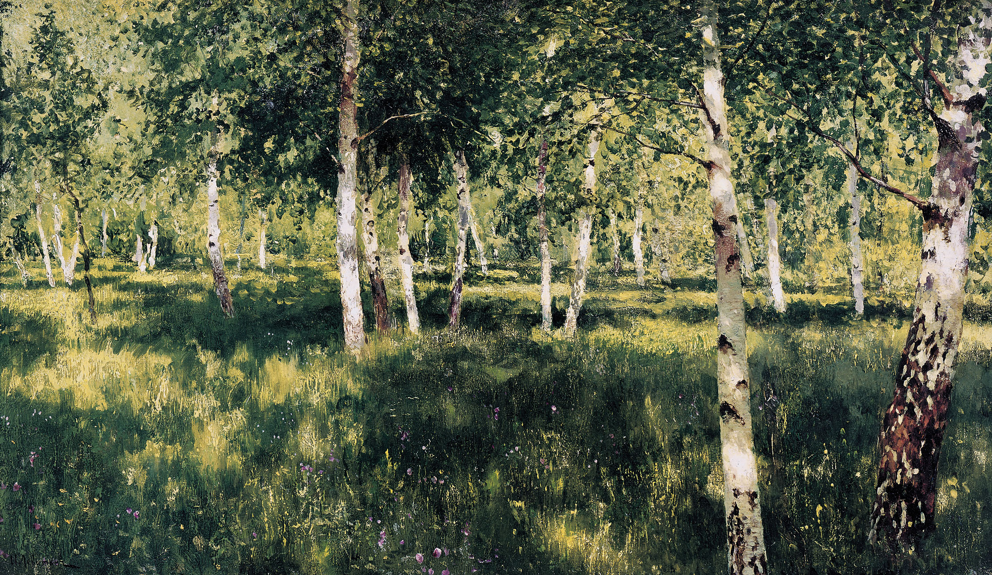
Geo
Official symbols
Capital of the country
“The Heart of Moscow”

